Slide 1
OCA Reference Architecture Recommendations Discussion
Organization of the Report
Purpose:
Create a “vision” document that can be used to communicate both internally and externally about the direction of OCA
Discussion Facets:
System architecture – What is the expected bounding of the OCA work? Actual bounding is determined by participants.
Context – How do we recommend that OCA works with other standards / governmental / trade bodies?

Slide 2

Architectural Descripition

Slide 3
Please Modify bubbles to list the MOST consequential
Please Modify
The OCA Role
(Plug & Play / Interoperability of Modules)
Objectives
Plug & play connection
Data exchange w/o modification
Assure compliance
The OCA Provides
Communication fabric
Control plane security
Module admission
Development tools
Data provenance
Vulnerabilities
Threat Feeds
Ticketing
Asset Database
Deception
A Communication
Fabric
SEIM
Configuration
Automation
Network Security
Endpoint
This architecture can be thought of as an open / multi-vendor SOAR platform
Note: This is not a comprehensive list of connections

Slide 4
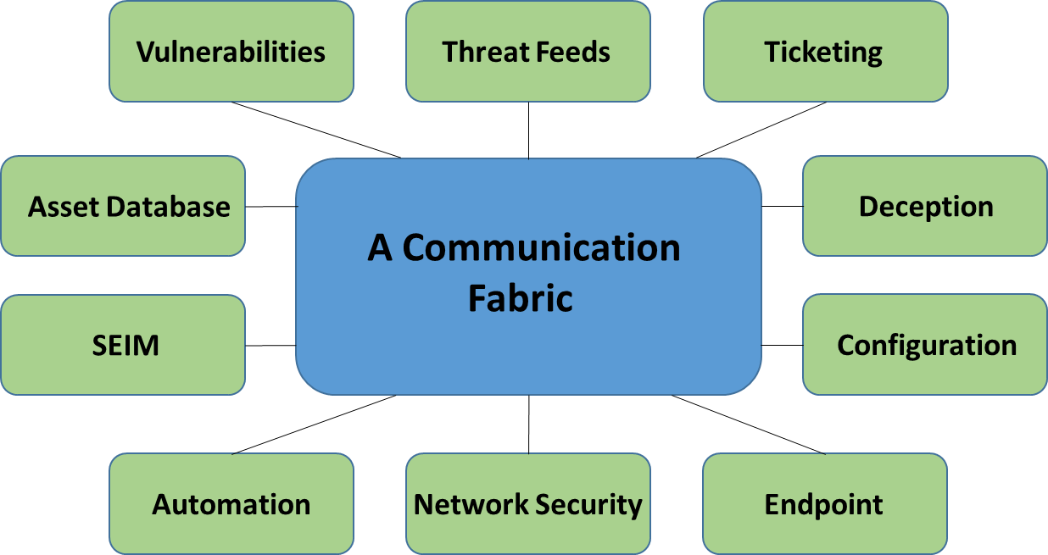
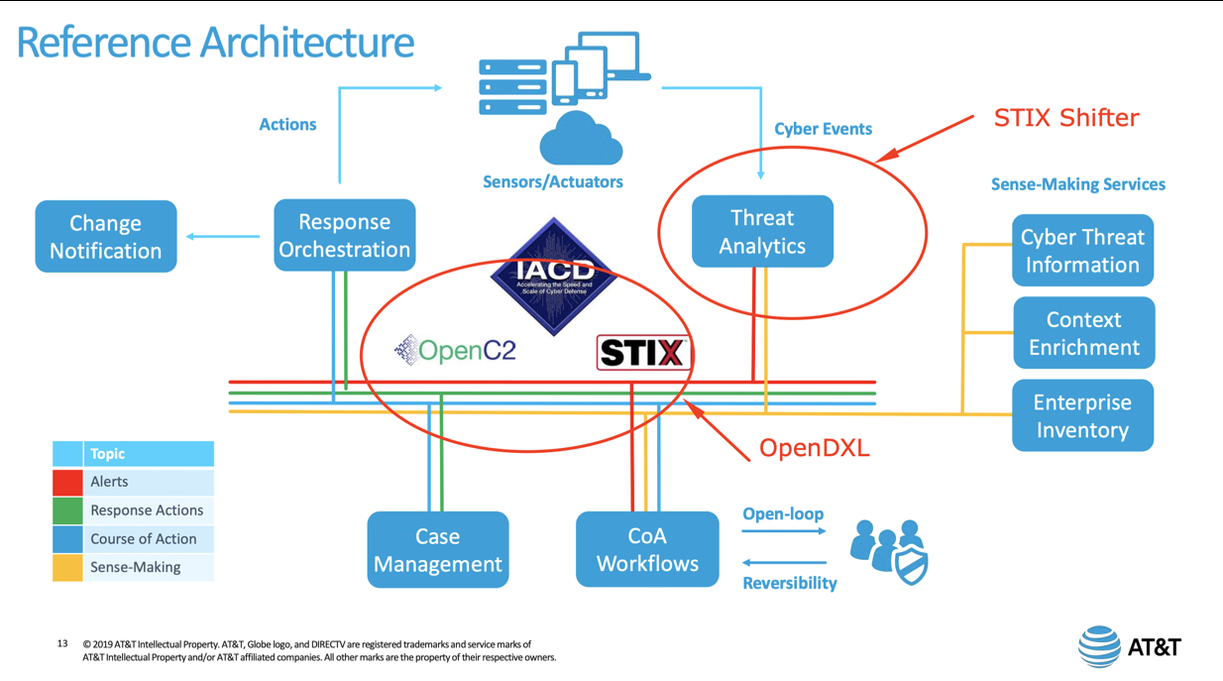
Please add new cartoons. One page per.
Sample Logic About New Cartoons
(Drill Down on Threat Feeds)
Some form of “You are Here” locator
Cartoon that drills down on the specific topic. Again, the idea is not to provide prescriptive detail generally (unless you are describing completed work

Slide 5
Elements To Consider For Inclusion Recommendations
I would expect that we develop cartoons that suggest the presence of these elements
Transport
Action Exchanges
Interface descriptions
Bandwidth sharing / Comms protocols
Network admission requirements
Sub/pub/ system logic
Identity certificates
Outage identification / heartbeat
Request for action
Description of expected actions
Action acknowledgement
Action response
System
Data Exchange
System metrics (examples)
BW available/used
Active modules
Module activity tracking
Data Formats / Including room for expansion
Data Provenance / Transit path
Data Synch Rules (Is everybody working from current?)
Odds & Ends
Data Quality
Playbook Exchange
How is identity & compliance asserted?
Data collection method
Data enrichment method
Data Provenance / Transit path
I’m including this to start the discussion. I’m hoping to tap your expertise to provide a more appropriate list. For instance, I have not heard OCA talk about standardizing playbook formats or recognizing existing formats. Opinions? Does IACD already have it that we can reference?

Slide 6
OCA’s Place In A World Context

Slide 7

An International Standards Context For OCA
Organization Name
Brief Description of Planned Work
Relevant Links
Proposed Relationship
ETC
Please add new Standards.
One per page.

